Slide 1

Obstacle Avoiding Car
Day 5

Slide 2
Today
Basic programming elements
Conditions
Functions

Slide 3
Conditions
Let something happen if some requirements are fulfilled.
For example,

Slide 4
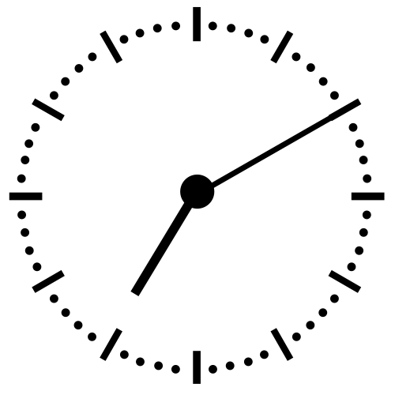

If this is Aftari time?
Have some food …

Slide 5
Similarly, in programming
if ( it is raining )
{
// look up, is there water falling on me?
if ( I have an umbrella )
{
OpenUmbrella();
//Opening Umbrella operation
}
}

Slide 6
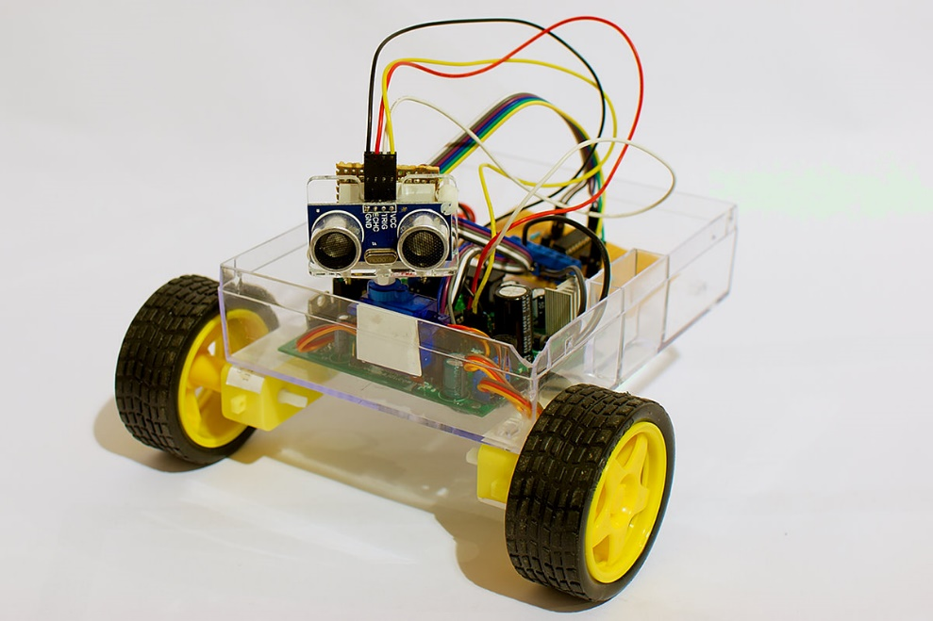
Today’s Task
We will make an obstacle avoiding car, and implement conditions in it.

Slide 7
What it will do?
Check if there is any hurdle
Stop if any hurdle appears
Move forward if there is no hurdle
Repeat the process

Slide 8
Let’s have a look at code!
void loop()
{
CheckDistance();
if(distance>15)
{
MoveForward();
}
}

Slide 9
Now looking inside …
Let us see what’s happening inside the functions!
void loop()
{
CheckDistance();
if(distance>15)
{
MoveForward();
}
}

Slide 10
Check Distance
void CheckDistance()
{
digitalWrite(trig, LOW);
delayMicroseconds(2);
digitalWrite(trig, HIGH);
delayMicroseconds(10);
digitalWrite(trig, LOW);
duration = pulseIn(echo, HIGH);
inches = duration/74/2;//converts time duration to inches
cm = duration / 29 / 2;//converts time duration to cm
distance = cm;
}

Slide 11
Let’s get started!
Now, we will see our code in chunks!
Check how Ultrasonic sensor works!
Measure the distance
Move the Car Forward
Combine both parts

Slide 12
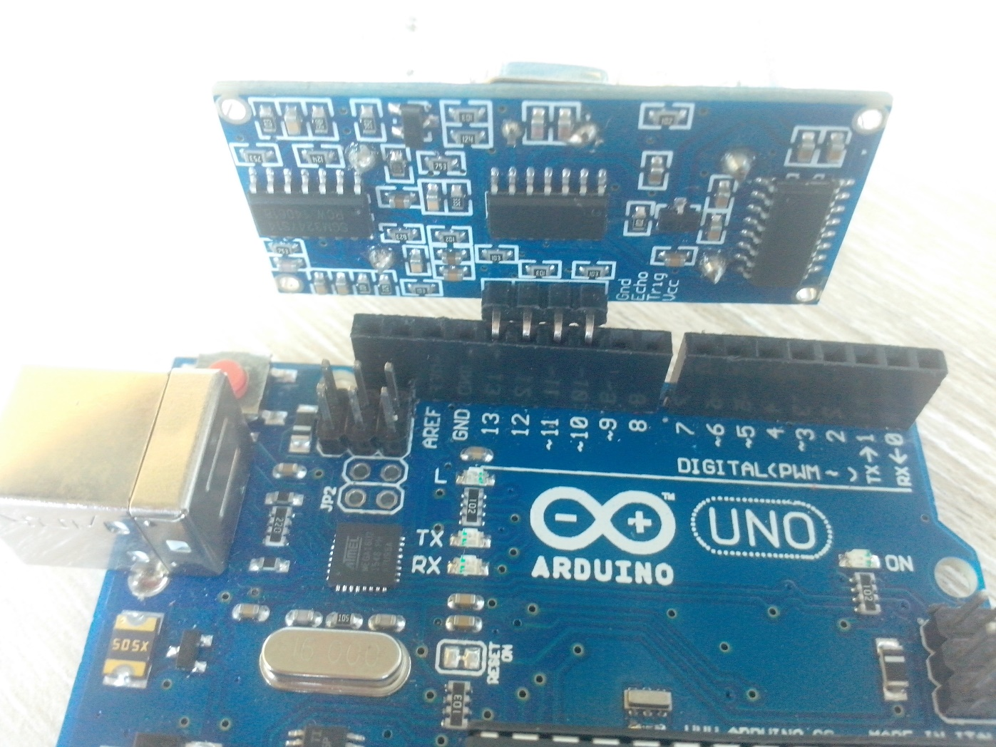
Connect the Sensor

Slide 13
Setup the Sensor
// ultrasonic sensor
const int VCC = 10;
const int trig = 11;
const int echo = 12;
const int GND = 13;

Slide 14
Understand the Configuration
void setup()
{
pinMode(VCC,OUTPUT);
pinMode(GND,OUTPUT);
digitalWrite(VCC,HIGH);
digitalWrite(GND,LOW);
pinMode(trig,OUTPUT);
pinMode(echo,INPUT);
Serial.begin(9600);
}

Slide 15
Move Forward
void MoveForward()
{
digitalWrite(in1, HIGH);
digitalWrite(in2, LOW);
analogWrite(enA, 150);
digitalWrite(in3, HIGH);
digitalWrite(in4, LOW);
analogWrite(enB, 150);
delay(1000);
}

Slide 16
Finally . . .
void loop()
{
CheckDistance();
Serial.println(distance);
if(distance<50)
{
Stop();
}
if(distance>50)
{
MoveForward();
}
}

